Slide 1
Command Design Pattern
The Command pattern aims to encapsulate method invocation, requests, or operations into a single object and gives us the ability to both parameterize and pass method calls around that can be executed at our discretion.
In addition, it enables us to decouple objects invoking the action from the objects which implement them, giving us a greater degree of overall flexibility in swapping out concrete classes (objects).
@ShankaragoudaG

Slide 2
Command Design Pattern
An abstract class defines an interface but doesn't necessarily provide implementations for all of its member functions. It acts as a base class from which others are derived. A derived class that implements the missing functionality is called a concrete class.
Base classes and concrete classes can be implemented in JavaScript(ES2015+) using the extends keyword applicable to the JavaScript classes.
The general idea behind the Command pattern is that it provides us a means to separate the responsibilities of issuing commands from anything executing commands, delegating this responsibility to different objects instead.

Slide 3
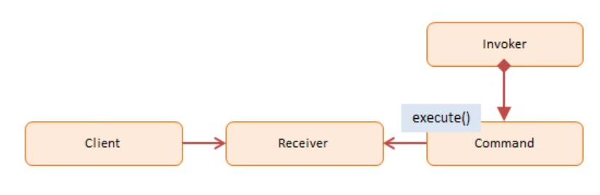
Command Pattern Usage
Suppose you are building an application that supports the Cut, Copy, and Paste clipboard actions. These actions can be triggered in different ways throughout the app: by a menu system, a context menu (e.g. by right clicking on a textbox), or by a keyboard shortcut.
Command objects allow you to centralize the processing of these actions, one for each operation. So, you need only one Command for processing all Cut requests, one for all Copy requests, and one for all Paste requests.
Digram->

Slide 4
Example
Client -- In example code: the run() function
references the Receiver object
Receiver -- In example code: Calculator
knows how to carry out the operation associated with the command
(optionally) maintains a history of executed commands
Command -- In example code: Command
maintains information about the action to be taken
Invoker -- In our example code: the user pushing the buttons
asks to carry out the request

Slide 5
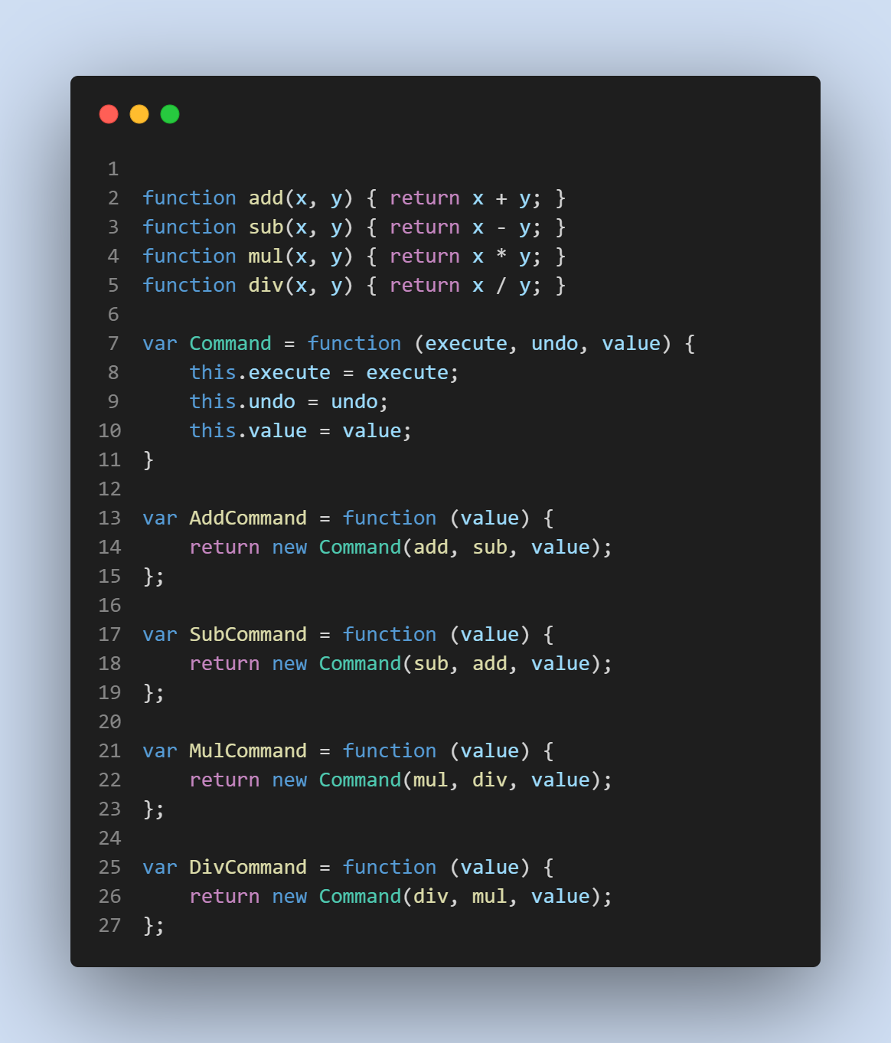
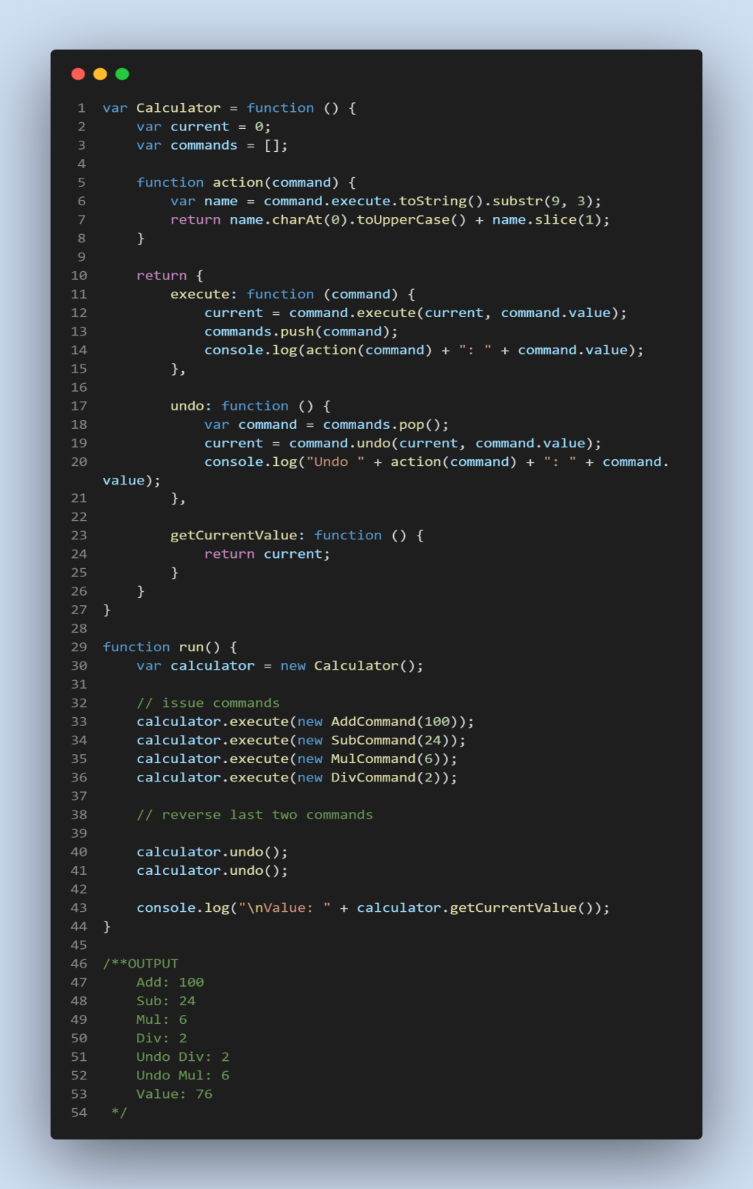

Slide 6
Useful Resources
https://www.oreilly.com/library/view/learning-javascript-design/9781449334840/ch09s08.html
https://www.patterns.dev/posts/classic-design-patterns/#commandpatternjavascript
https://www.dofactory.com/javascript/design-patterns/command

